Slide 1
Module 1

Slide 2
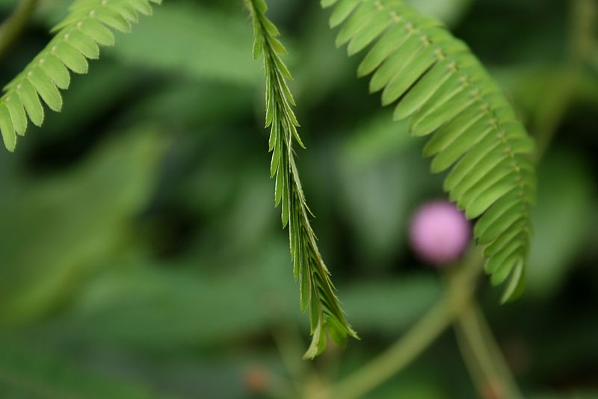
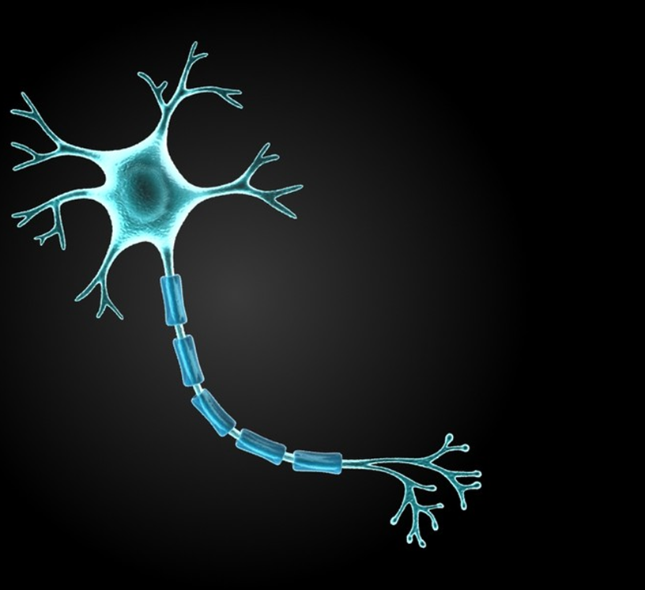
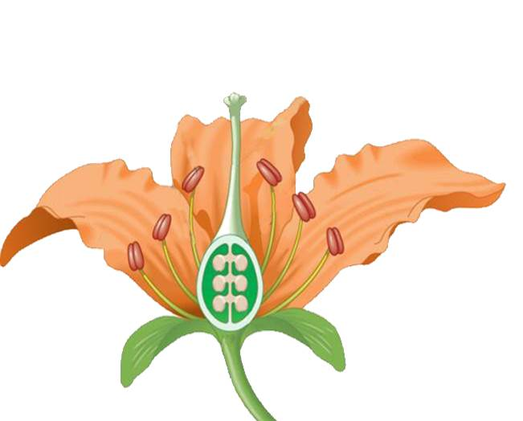
07. Control and Coordination

Slide 3
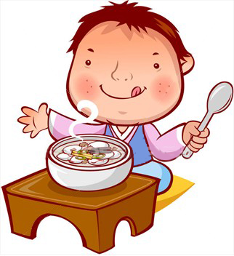
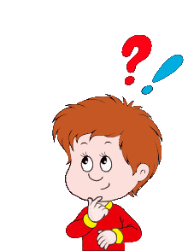
What happens when we see tasty food?
How do we feel when someone hurts us?
What we do when we feel cold?
We shiver
We feel sad or we cry
Saliva comes out from our mouth
Regulating
What is controlling emotions inside our body?
There is something inside our body which is controlling our body and our emotions.
This is what we will study in the chapter

Slide 4
07. Control and Coordination

Slide 5
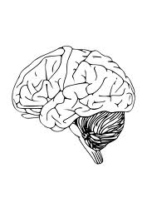
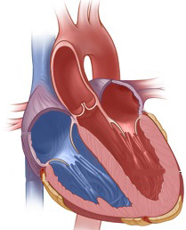
Life
Consists of
Living organisms
Cells
What are living organisms made up of ?
It is the basic structural and functional unit of life
Group of cells are called as
Organ system
Cell
Tissues
Group of tissues are called as
Organism
Organs

Slide 6
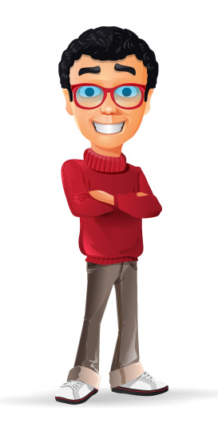
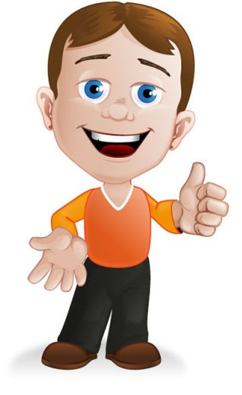
Let us understand with an example
But how does this organism function ?
Organism

Slide 7
Thank You

